Slide 1
Describing Data: Frequency Tables, Frequency Distributions, and Graphic Presentation
2
Notes:
‹#›

Slide 2
GOALS
Organize qualitative data into a frequency table.
Present a frequency table as a bar chart or a pie chart.
Organize quantitative data into a frequency distribution.
Present a frequency distribution for quantitative data using histograms, frequency polygons, and cumulative frequency polygons.
Notes:
‹#›

Slide 3
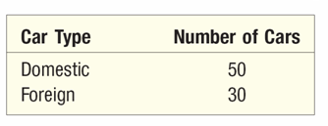
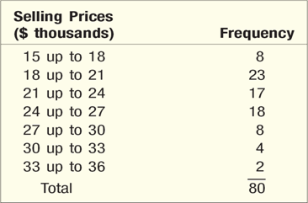
Frequency Table and Frequency Distribution
FREQUENCY TABLE A grouping of qualitative data into mutually exclusive classes showing the number of observations in each class.
Class interval: The class interval is obtained by subtracting the lower limit of a class from the lower limit of the next class.
Class frequency: The number of observations in each class.
Class midpoint: A point that divides a class into two equal parts. This is the average of the upper and lower class limits.
FREQUENCY DISTRIBUTION A grouping of data into mutually exclusive
classes showing the number of observations in each class.
Notes:
‹#›

Slide 4
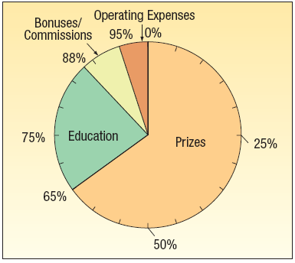
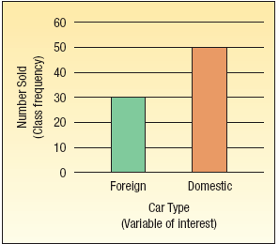
Pie Charts and Bar Charts
PIE CHART A chart that shows the proportion or percent that each class represents of the total number of frequencies.
BAR CHART A graph in which the classes are reported on the horizontal axis and the class frequencies on the vertical axis. The class frequencies are proportional to the heights of the bars.
Notes:
‹#›

Slide 5
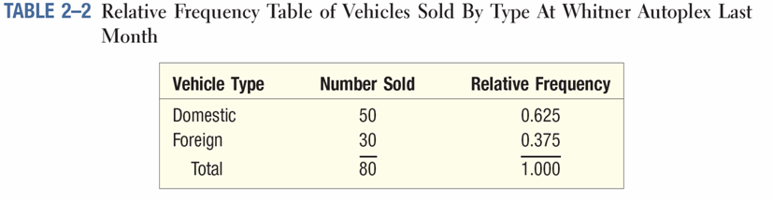
Relative Class Frequencies
Class frequencies can be converted to relative class frequencies to show the fraction of the total number of observations in each class.
A relative frequency captures the relationship between a class total and the total number of observations.
Notes:
‹#›

Slide 6
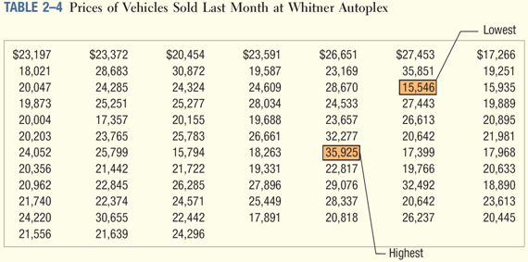
EXAMPLE – Creating a Frequency Distribution Table
Ms. Kathryn Ball of AutoUSA wants to develop tables, charts, and graphs to show the typical selling price on various dealer lots. The table on the right reports only the price of the 80 vehicles sold last month at Whitner Autoplex.
Notes:
‹#›

Slide 7
Constructing a Frequency Table - Example
Step 1: Decide on the number of classes.
A useful recipe to determine the number of classes (k) is the “2 to the k rule.” such that 2^{k} > n.
There were 80 vehicles sold. So n = 80. If we try k = 6, which means we would use 6 classes, then 2⁶ = 64, somewhat less than 80. Hence, 6 is not enough classes. If we let k = 7, then 2⁷ 128, which is greater than 80. So the recommended number of classes is 7.
Step 2: Determine the class interval or width.
The formula is: i ≥ (H-L)/k where i is the class interval, H is the highest observed value, L is the lowest observed value, and k is the number of classes.
($35,925 - $15,546)/7 = $2,911
Round up to some convenient number, such as a multiple of 10 or 100. Use a class width of $3,000
Notes:
‹#›

Slide 8
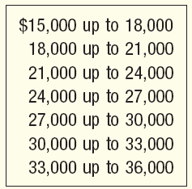
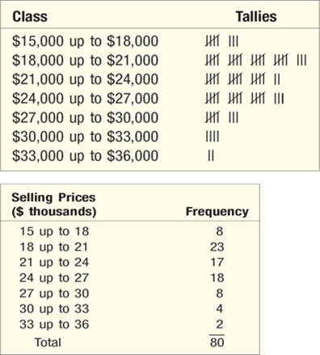
Constructing a Frequency Table - Example
Step 3: Set the individual class limits
Step 4: Tally the vehicle selling prices into the classes.
Step 5: Count the number of items in each class.
Notes:
‹#›

Slide 9
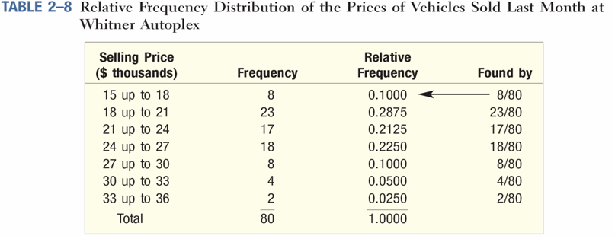
Relative Frequency Distribution
To convert a frequency distribution to a relative frequency distribution, each of the class frequencies is divided by the total number of observations.
Notes:
‹#›

Slide 10
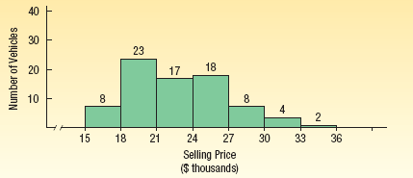
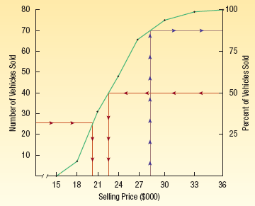
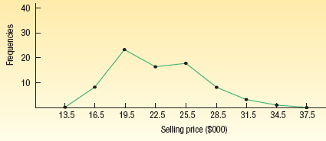
Graphic Presentation of a Frequency Distribution
The three commonly used graphic forms are:
Histograms
Frequency polygons
Cumulative frequency distributions
Notes:
‹#›

Slide 11
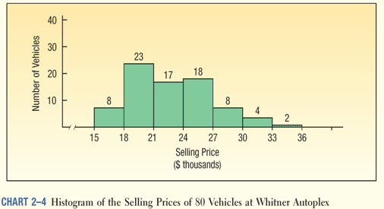
Histogram
HISTOGRAM A graph in which the classes are marked on the horizontal axis and the class frequencies on the vertical axis. The class frequencies are represented by the heights of the bars and the bars are drawn adjacent to each other.
Notes:
‹#›

Slide 12
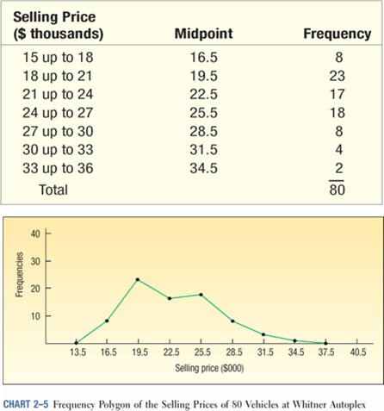
Frequency Polygon
A frequency polygon also shows the shape of a distribution and is similar to a histogram.
It consists of line segments connecting the points formed by the intersections of the class midpoints and the class frequencies.
Notes:
‹#›

Slide 13
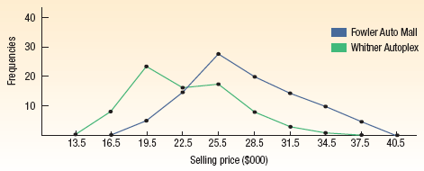
Histogram Versus Frequency Polygon
Both provide a quick picture of the main characteristics of the data (highs, lows, points of concentration, etc.)
The histogram has the advantage of depicting each class as a rectangle, with the height of the rectangular bar representing the number in each class.
The frequency polygon has an advantage over the histogram. It allows us to compare directly two or more frequency distributions.
Notes:
‹#›

Slide 14
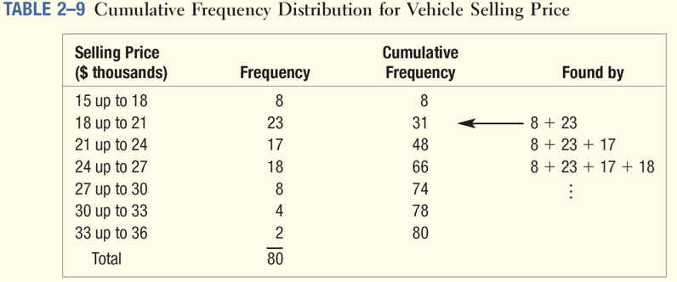
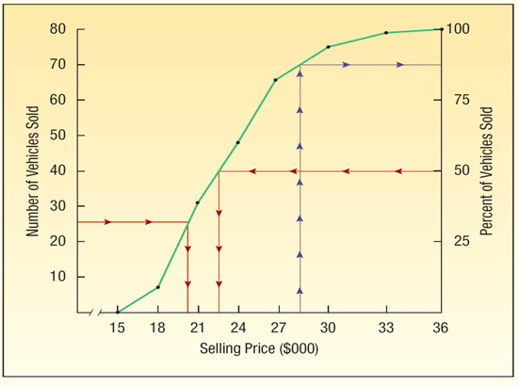
Cumulative Frequency Distribution
Notes:
‹#›

